Slide 1

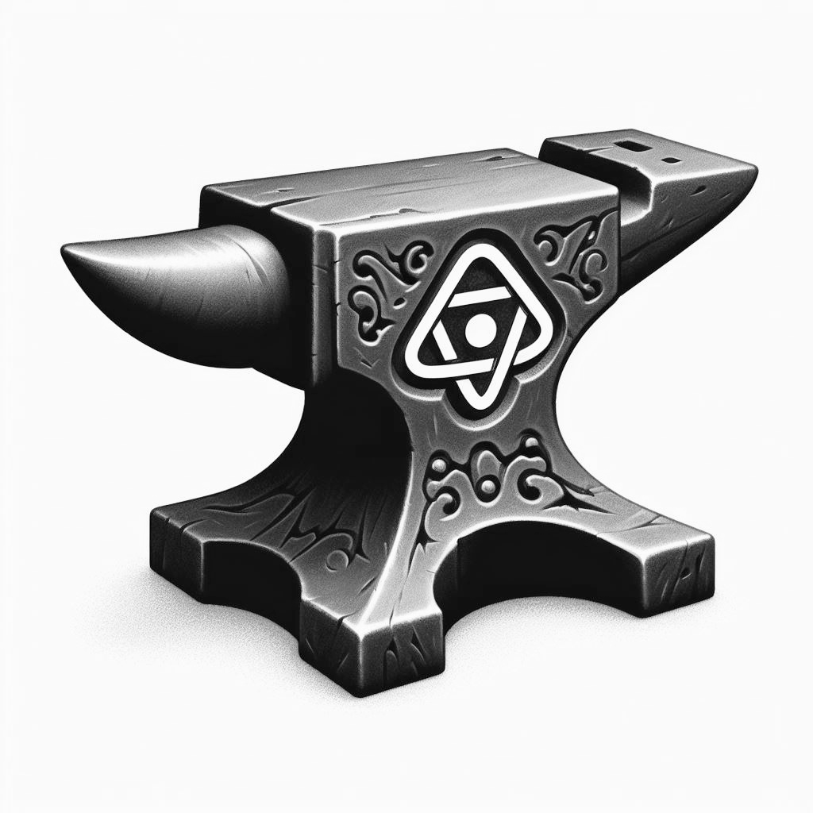

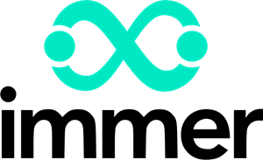


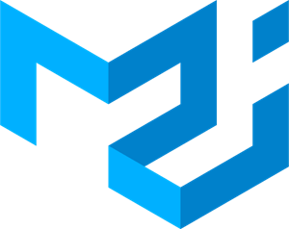
Skyforge Coding
Conquer libraries in React.js projects
Eric Santana

Slide 2


Improving React.js
A Comprehensive Guide to Essential Libraries.
This ebook is your roadmap to becoming proficient in React.js development, with a focus on leveraging key libraries such as Vite, Immer, React Hook Form, Material UI, and React Router. Each chapter will provide practical examples and insights to help you understand how these libraries enhance your React.js projects.

Slide 3

Chapter 1
Accelerate Development with Vite

Slide 4


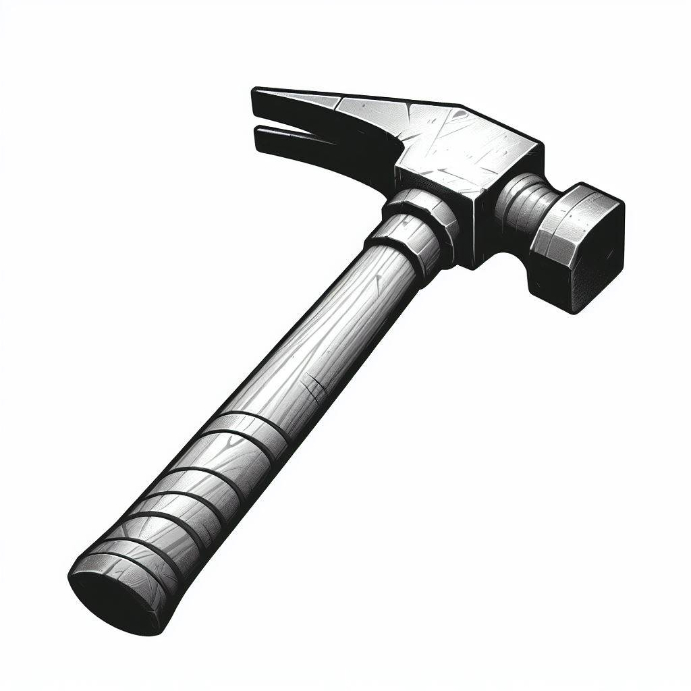
Accelerate Development with Vite
a next-generation build tool
Vite is an innovative build tool, to streamline your React.js development process.
This tool leverages native ES module imports to offer a fast development experience.

Slide 5
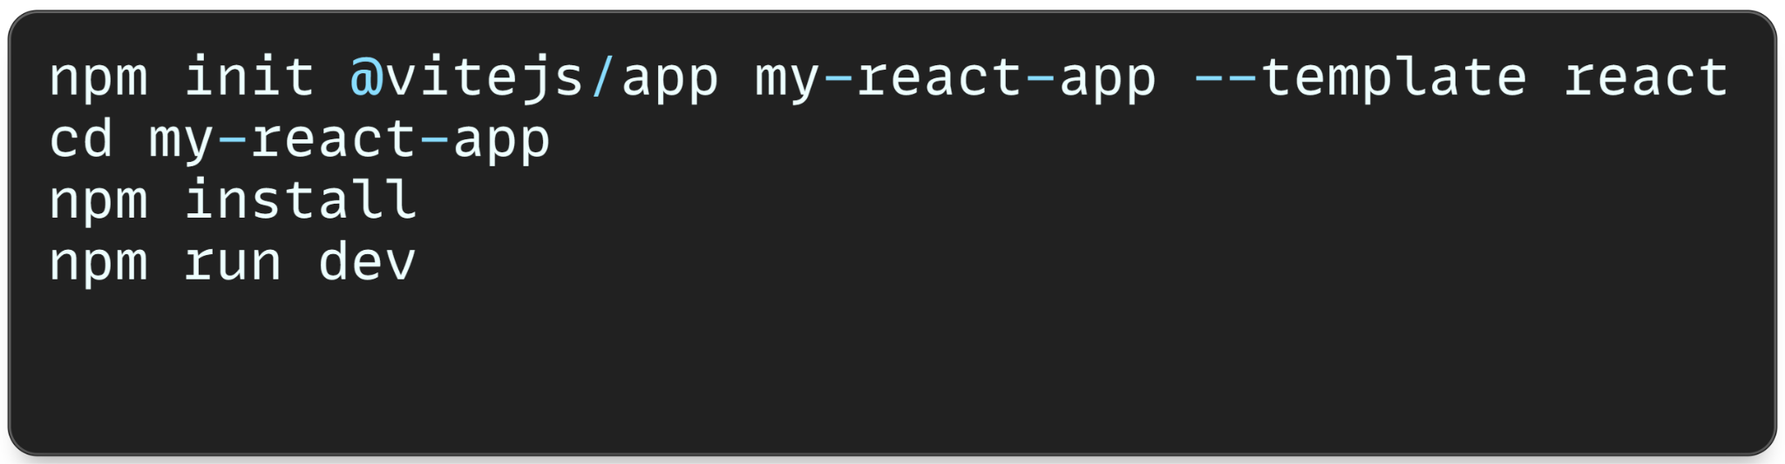
Accelerate Development with Vite
Vite eliminates the need for bundling during development, it serves your code directly from an optimized development server.
Let’s get started and look how to forge it in your project.

Slide 6
Capítulo 2
Tame the state management with Immer

Slide 7
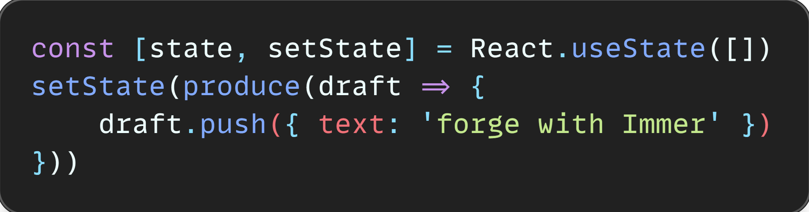
Tame the state with Immer
Simplify State Management
With the power of Immer, object mutation no longer needs to be made throughout arrays.
Immer allows you to work with immutable objects in a way that feels mutable. thus removing the need to create new objects when updating a state.

Slide 8
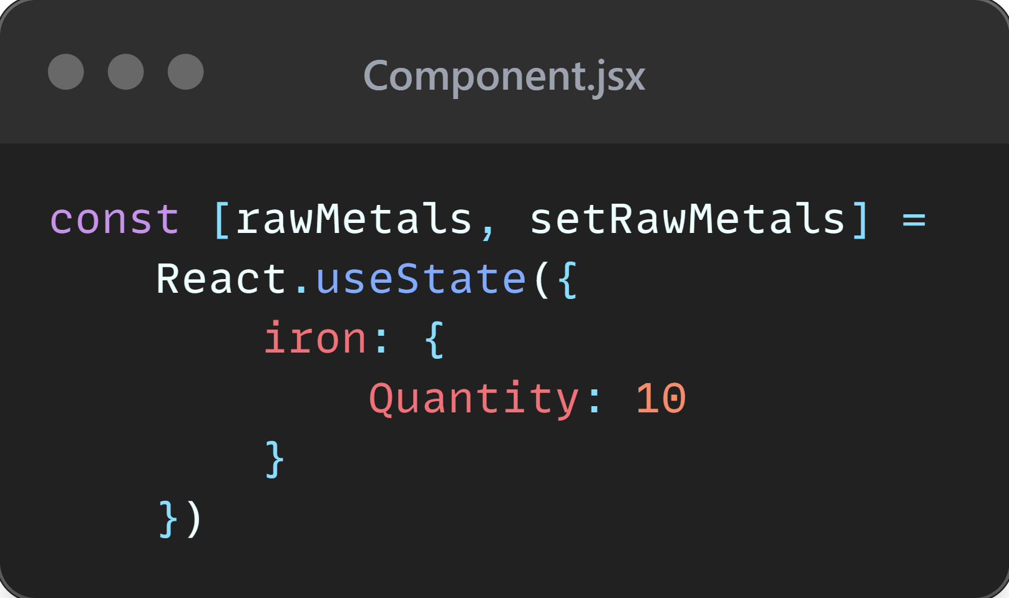
Tame the state with Immer
Comparison
For the comparison of the old way and the immer way to renew the state, let’s say we want to revise the quantity of iron in stock:

Slide 9
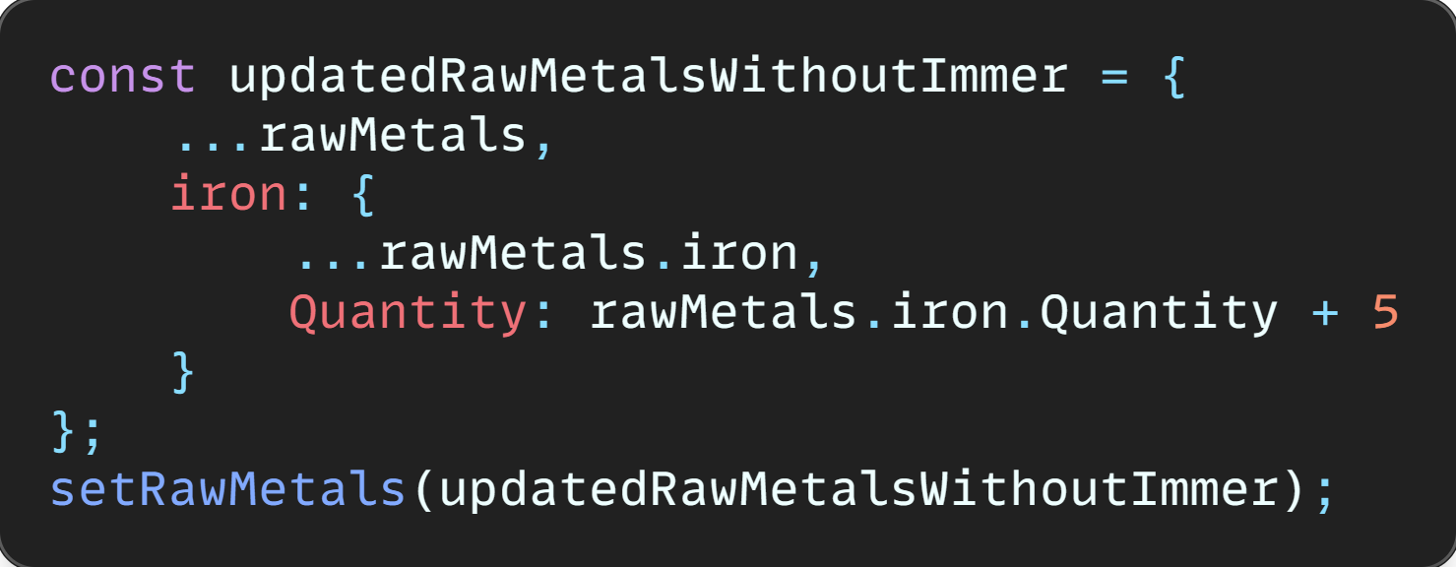
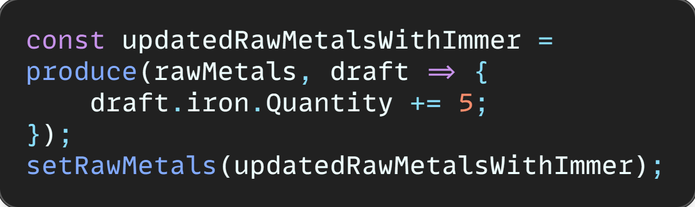
Tame the state with Immer
Comparison
Without Immer:
With Immer:

Slide 10
Capítulo 3
Unlock the Pathways with React Router

Slide 11

Unlock the Pathways with React Router
Effortless Navigation
React Router allows you to navigate between different parts of your app without actually reloading the page.
It simplifies routing in React.js applications, allowing intuitive and dynamic navigation between different components.

Slide 12
Unlock the Pathways with React Router
Effortless Navigation
Some advantages of using React Router in your project:
Single-page Application (SPA) Support.
You can define your routes in a declarative way using JSX.
Nested Routing: you to create complex page structures with multiple levels.
Dynamic Routing: You can dynamically render routes

Slide 13
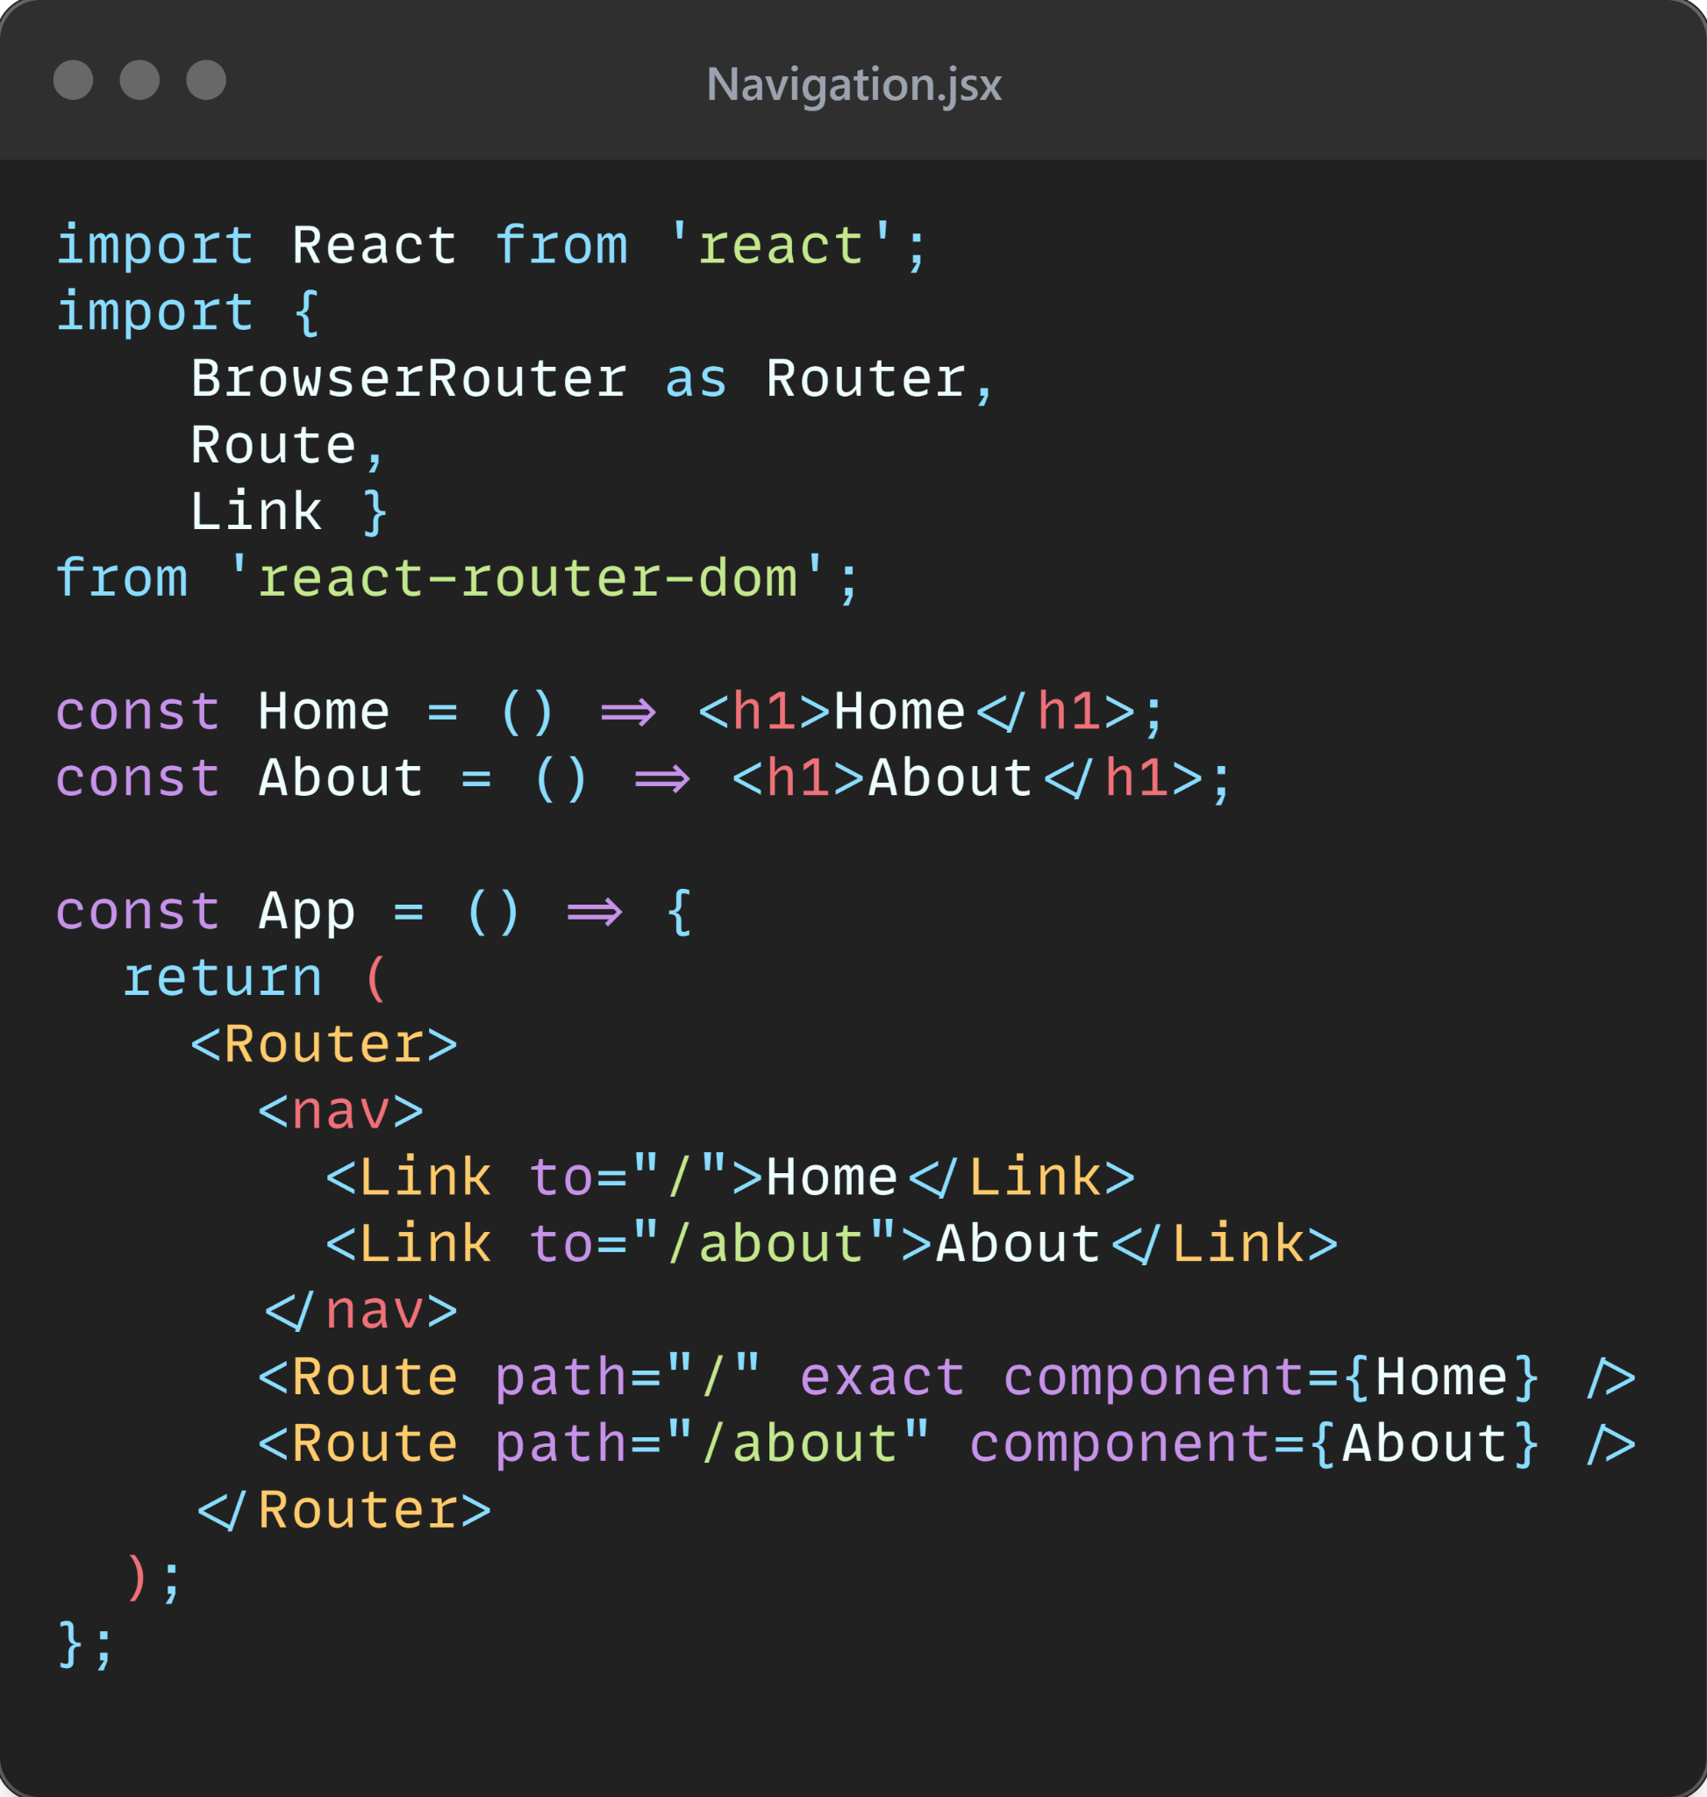
Unlock the Pathways with React Router
Effortless Navigation
Behold a example showcasing the implementation of React Router in your code.

Slide 14
Capítulo 4
Streamline Forms with React Hook Form

Slide 15
Streamline Forms with React Hook Form
Handling Forms Better
At its core, React Hook Form is a library that leverages the power of React's hooks to streamline form handling.
Wield the power of hooks to effortlessly capture form data, validate inputs, and handle form submission with finesse.

Slide 16
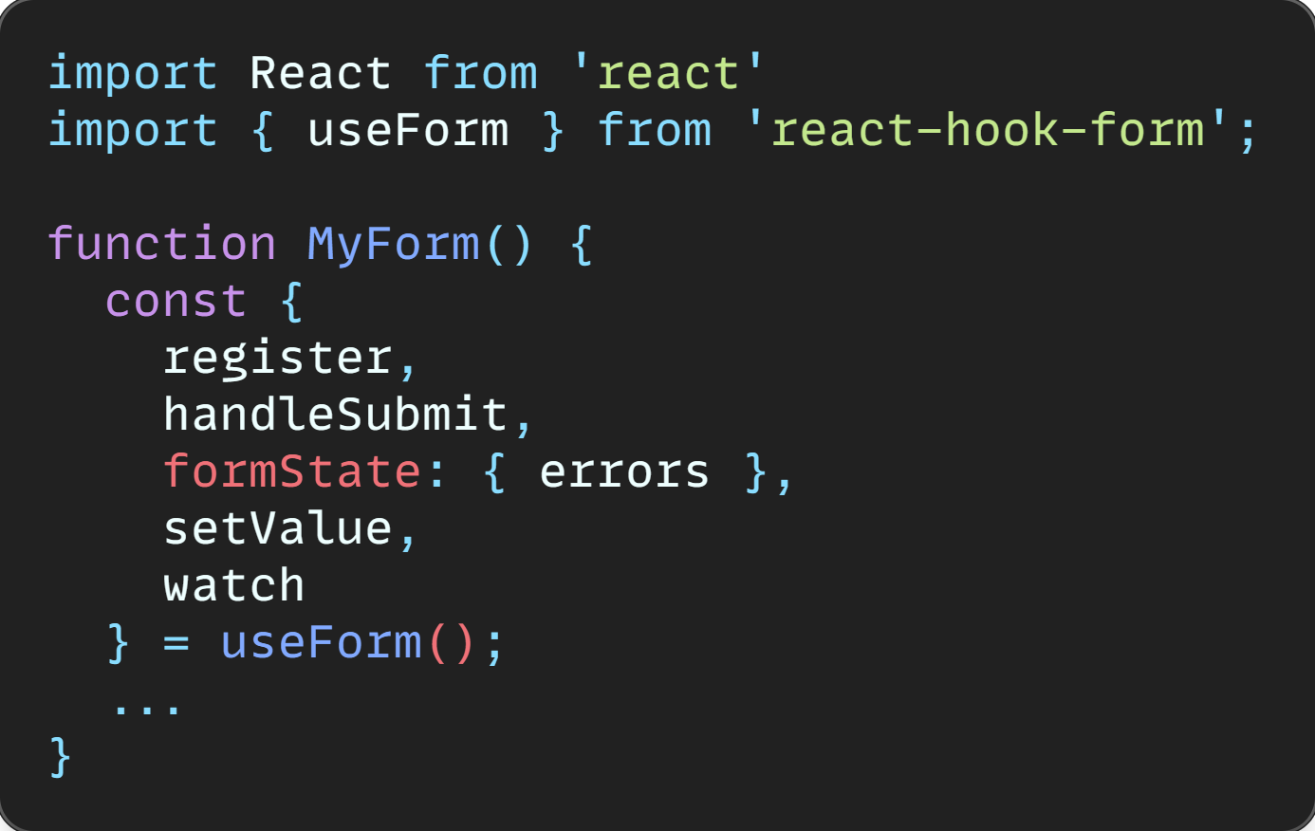
Streamline Forms with React Hook Form
Handling Forms Better
Let’s initialize the React hook form with the resources inside his useForm hook:
The returned values of this hook will be use for basic use, validation and controlled components.

Slide 17
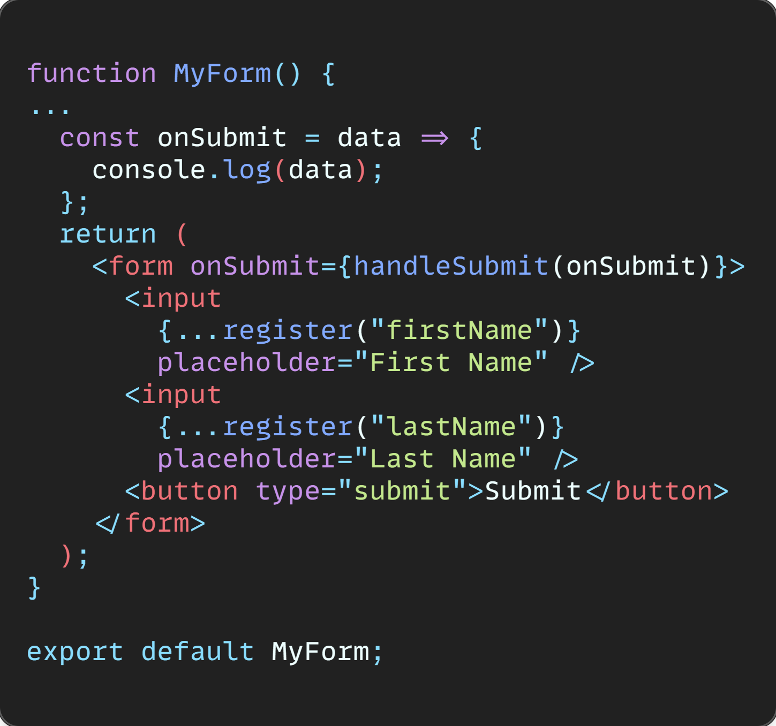
Streamline Forms with React Hook Form
Basic Usage
Basic Form with Input Field:

Slide 18
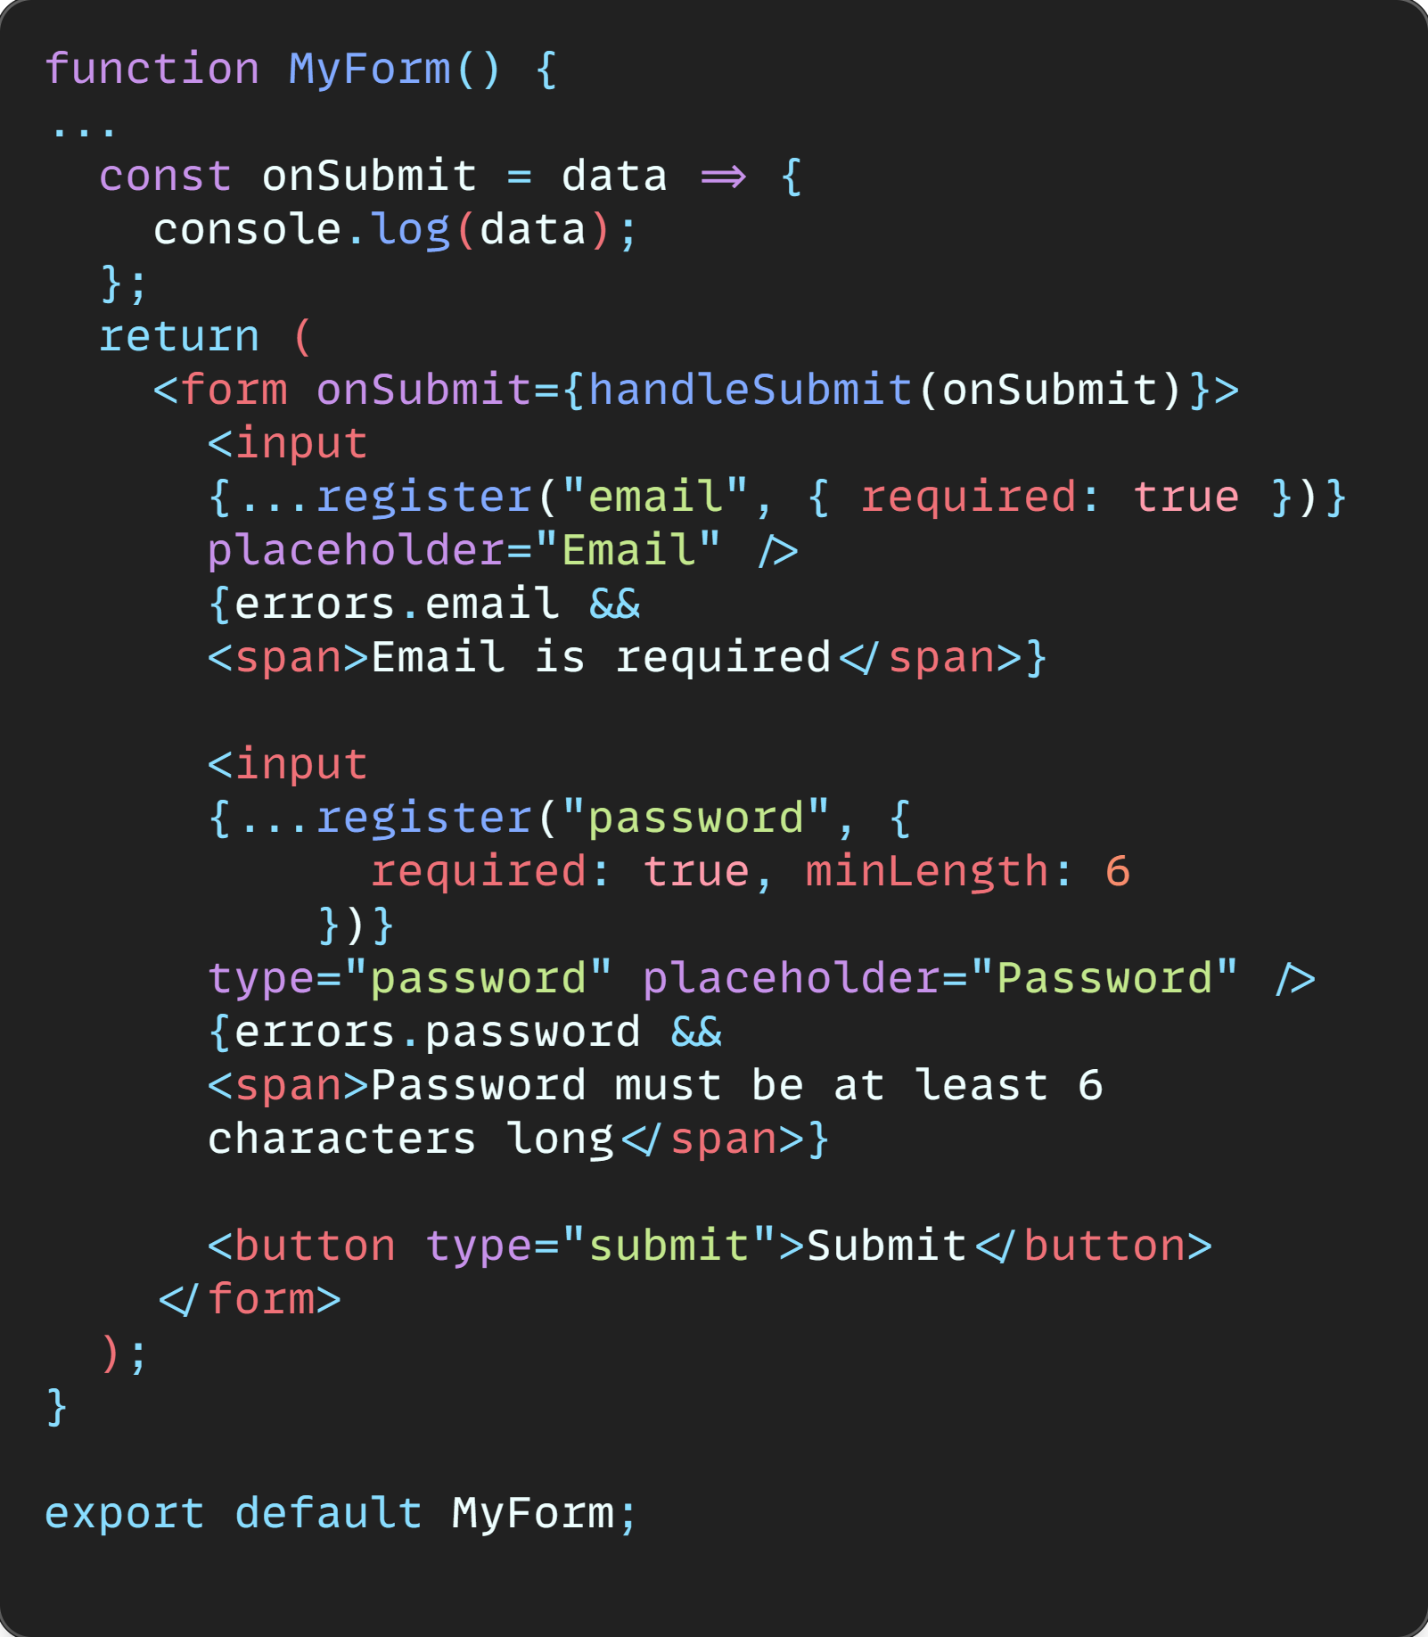
Streamline Forms with React Hook Form
Validation
Form with Validation:

Slide 19
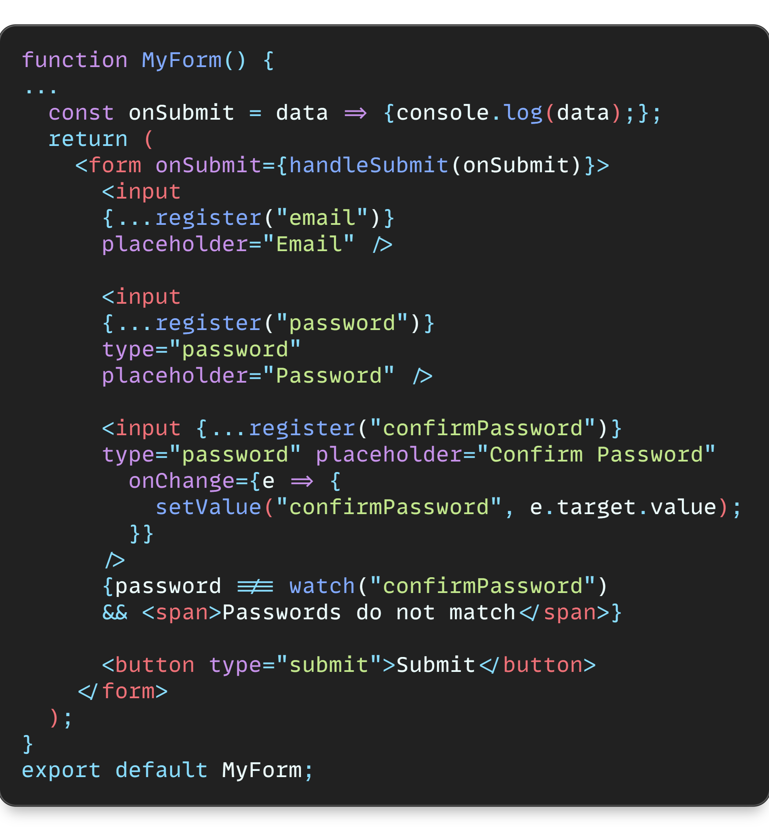
Streamline Forms with React Hook Form
Controlled
Form with Controlled Components:

Slide 20
Capítulo 5
Crafting Excellence: Material-UI for React

Slide 21
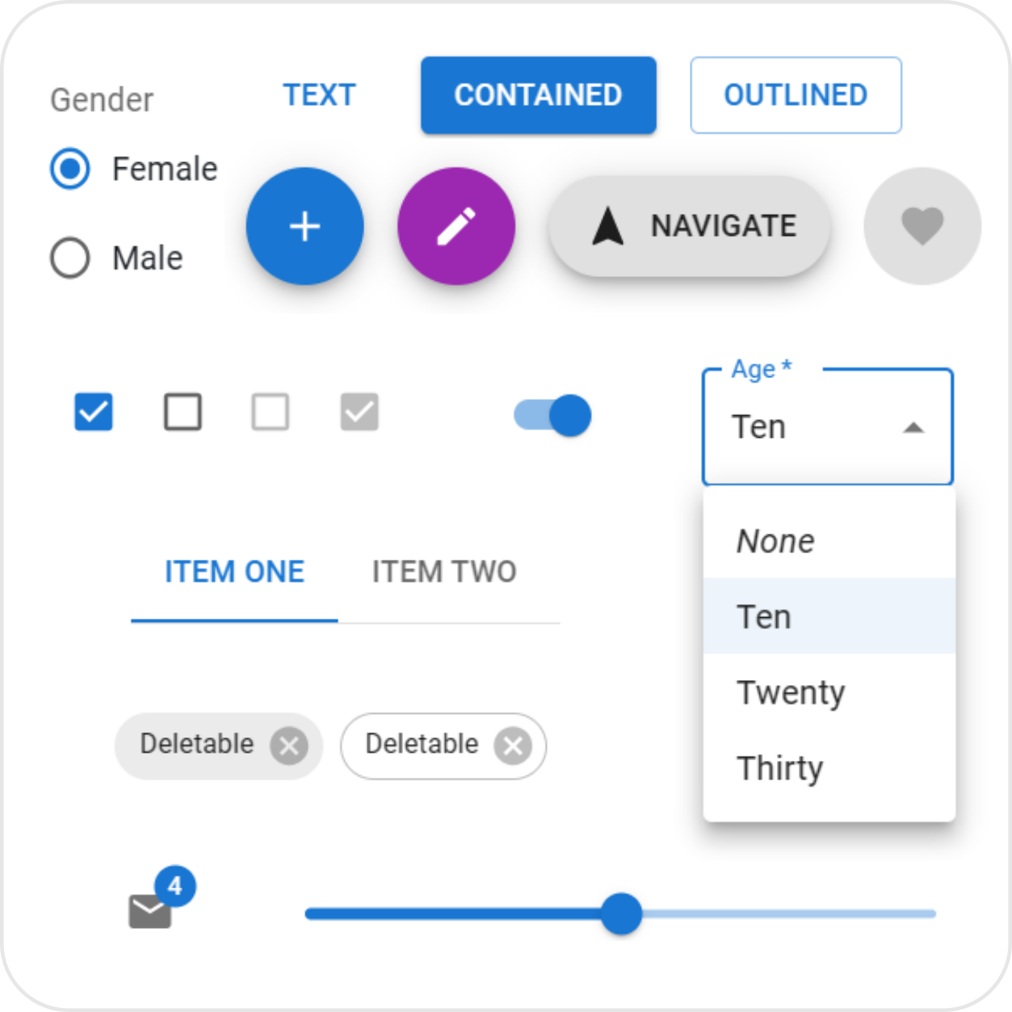
Crafting Excellence: Material-UI for React
Enhance UI
Material-UI simplifies the UI development process by providing ready-to-use components that follow Material Design guidelines. This ensures consistency and enhances user experience across applications.

Slide 22
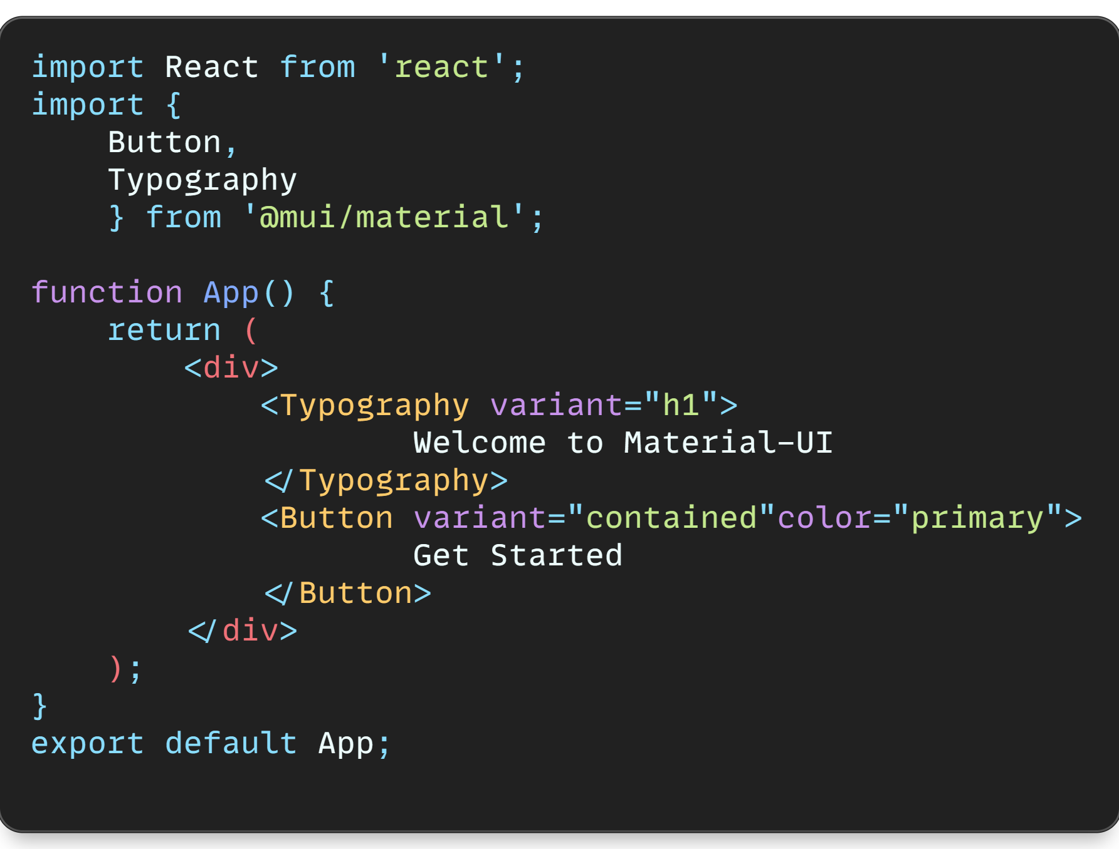
Crafting Excellence: Material-UI for React
Enhance UI
Let's dive into a code example to illustrate how to use Material-UI components in a React application.

Slide 23
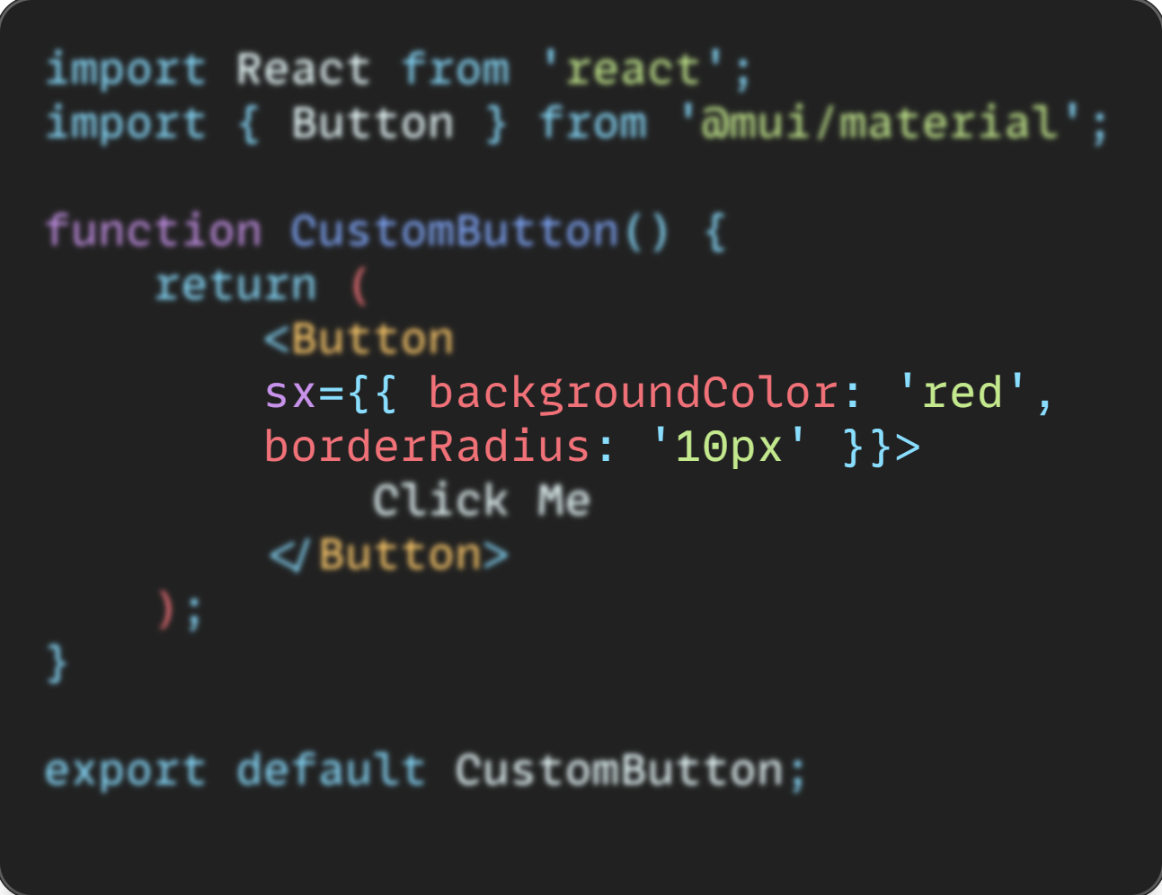
Crafting Excellence: Material-UI for React
Theming
If you want to change the look and feel of a component, you can customize it in multiple ways. In the code below the Overriding Styles:

Slide 24
Crafting Excellence: Material-UI for React
Enhance UI
Remember, mastering Material-UI takes time and practice. Start by experimenting with small projects and gradually incorporate more advanced features as you become more comfortable. With dedication and perseverance, you'll soon become proficient in leveraging Material-UI to build stunning user interfaces.

Slide 25
Ending

Slide 26


Thank you for reading this far.
This book was produced by a human and in collaboration with an AI, with several sections generated by artificial intelligence and edited and typeset by a human.
This book was produced for educational purposes and free reading, do not resell.
Connect with me
https://github.com/efms25
https://www.linkedin.com/in/eric-santana-955812159/

